Slide 1
Preparation of Research Proposals to get Financial Assistance from GoI:
Anusandhan National Research Foundation (ANRF) and avenues
S. B. Pandey, ARIES – Nainital,
Former Scientist-G, SERB, ANRF-DST
AI-Manthan 2026, AKTU Lucknow, 28 Jan 2026

Slide 2
Indian Academic Eco-system:
~ 166 institutions of National importance, 1100+ universities and nearly 45000+ colleges
~ Number of undergraduate, post-graduate and PhD student > 4.3 Cr
~ Number of PG teachers 15 lakhs
~ 3rd position in terms of number of publications in SCI journals and 3rd position in no. of PhDs in science
~ 3.6 L / 5.5 L R&D personnel are full time researchers (18% of the total 3.6L are women)
~ No of researchers per million population is just 262 (in comparison to 8714 in South Korea)
~ Gross domestic expenditure on R&D (GERD) is 0.64% of the Gross Domestic Product (GDP) for 20-21
~ Availability of Extra-mural funding by DST/DBT/others and their distribution to Tier-I Vs Tier II/III institutions
~ Teaching Vs. Research priority and uneven distribution of R&D infrastructure

Slide 3
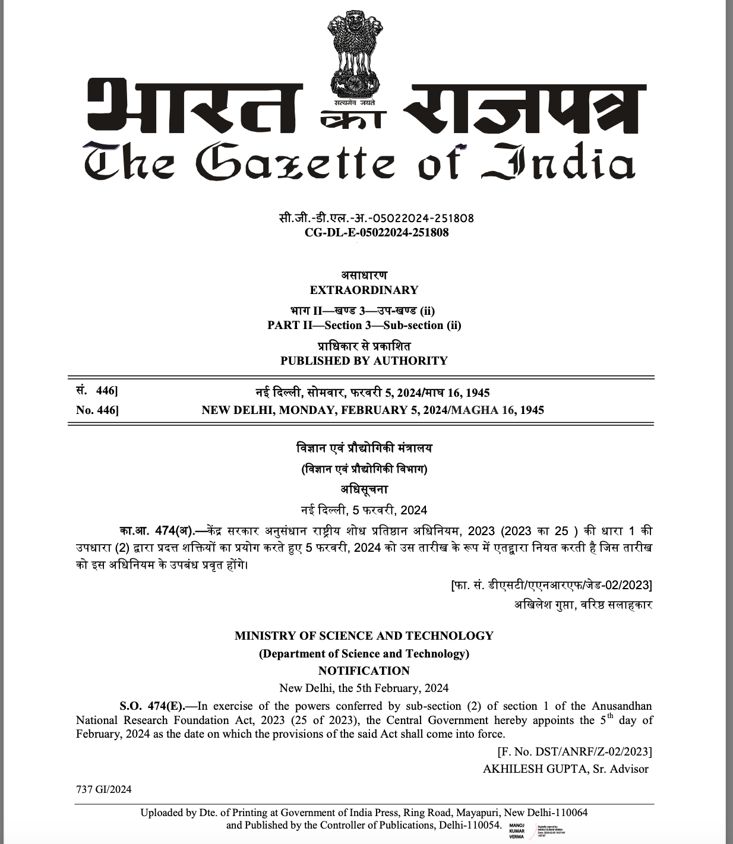
Concept of Anusandhan National Research Foundation (ANRF) is a key initiative proposed under
National Education Policy (NEP) 2020…..
An apex body to provide high-level strategic direction for research, innovations across
disciplines……
Accordingly, SERB-2008 was dissolved through an Act of Parliament

Slide 4
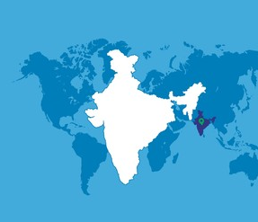



Strategic Interventions of ANRF
Hub and Spoke Framework for uplifting S&T ecosystem of Universities and Colleges
Boosting Research Capabilities in Universities
Mission Mode Research: Sectoral Investments, and Translational Research
Propelling India’s Global Competitiveness in Priority Areas
PM Early Career Grant, Advanced Research Grant, PM Professorship
Highly Skilled Workforce
Improving Global Ranking of India in top 100 Institutions
Centers of Excellence

Slide 5
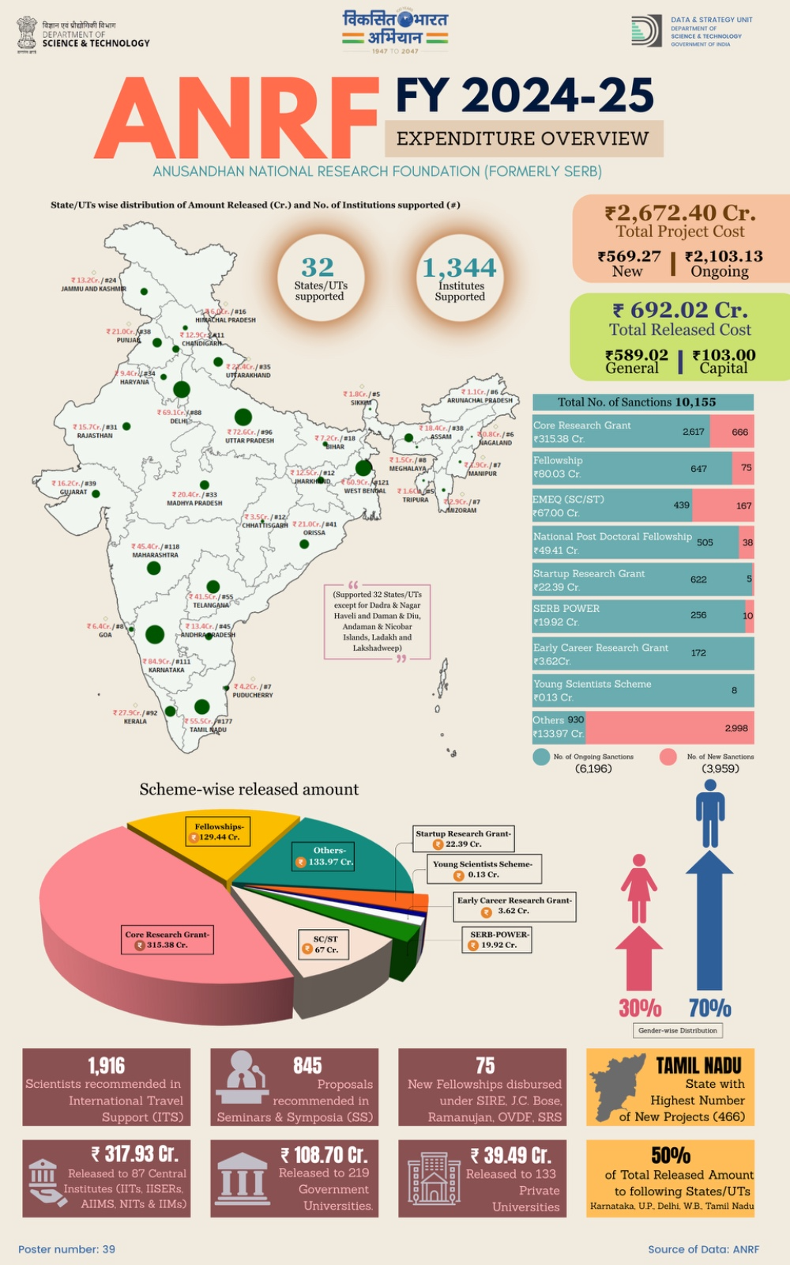

Slide 6
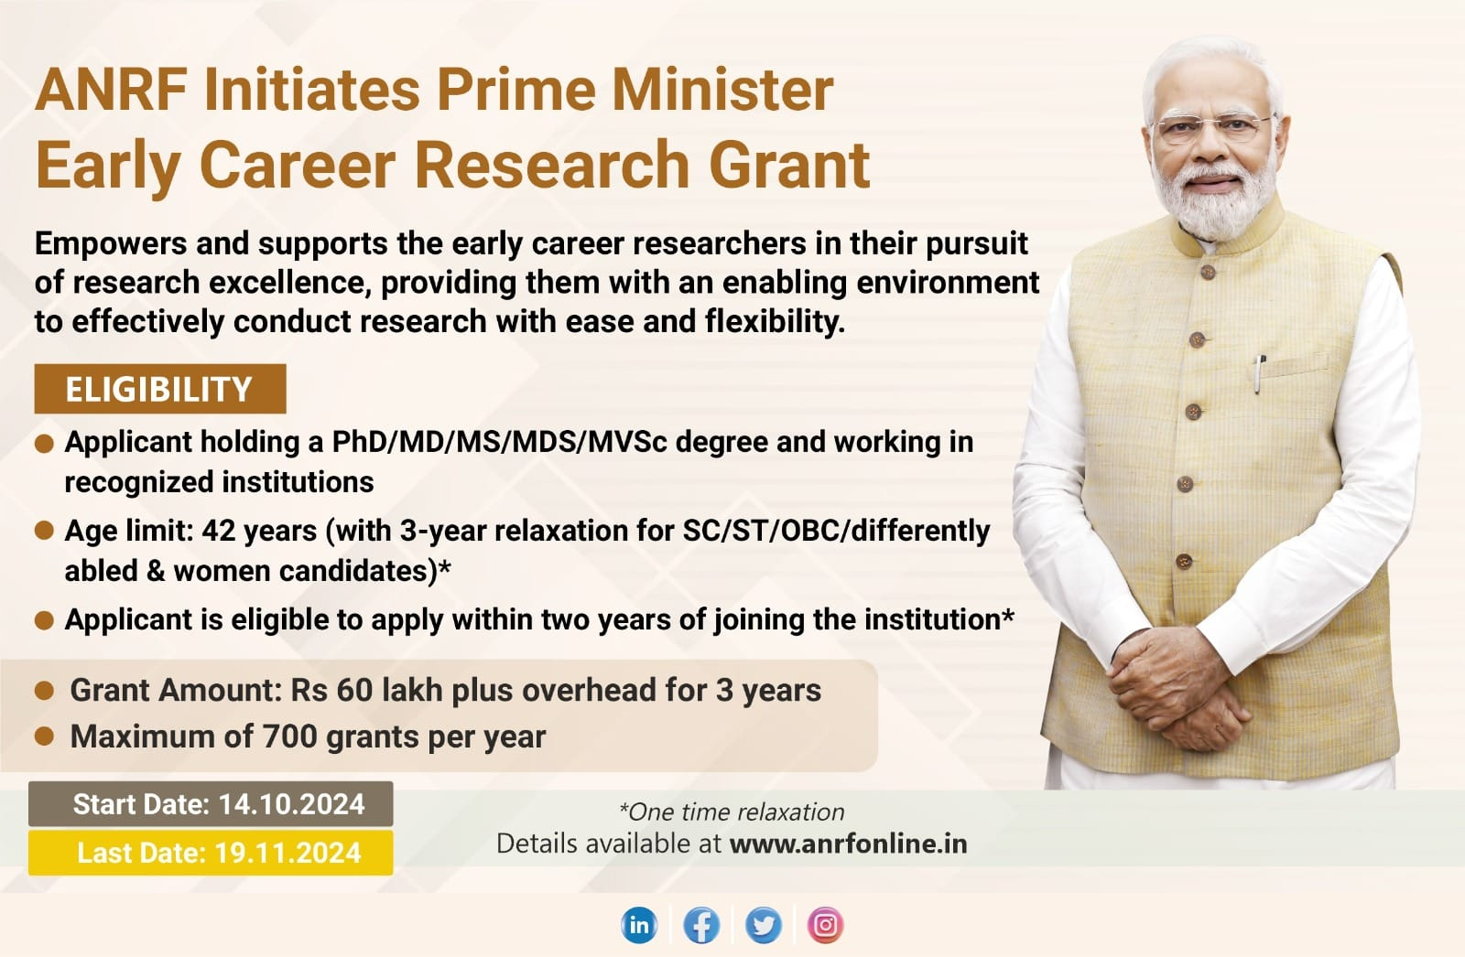

Slide 7
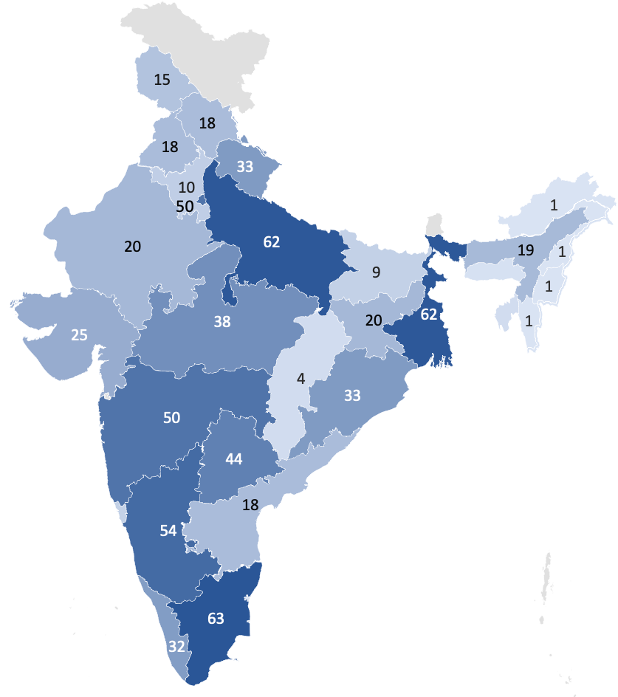
Prime Minister Early Career Research Grant (PMECRG)
ANRF: Horizontal
Governing Board approved and named the early career program as Prime Minister Early Career Research Grant
Program to support early career researchers in their pursuit for research excellence
Flexible budget and progressive initiatives for ease of doing research introduced
718 Young Researchers Supported
718 Early Career Researchers supported

Slide 8
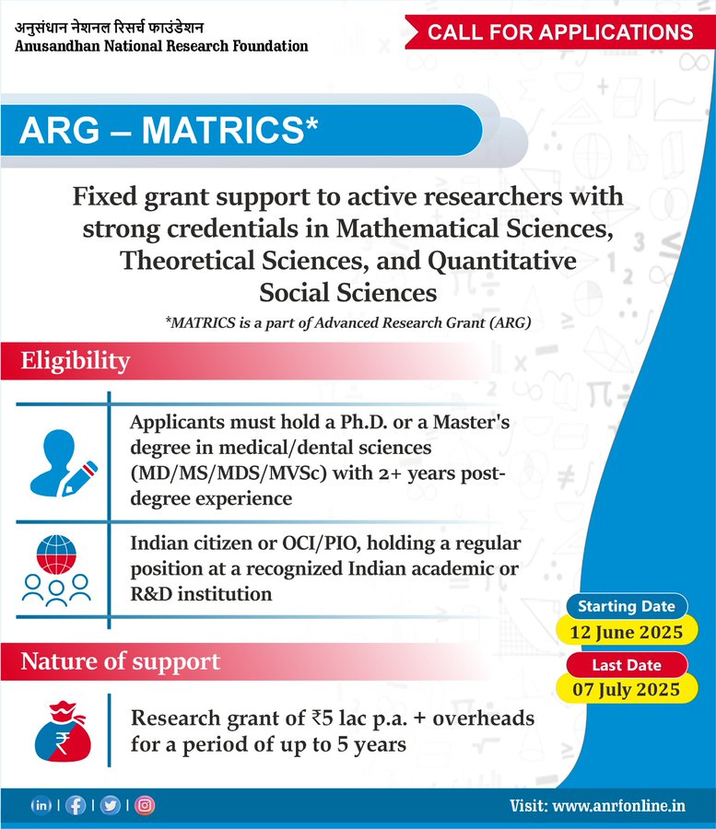
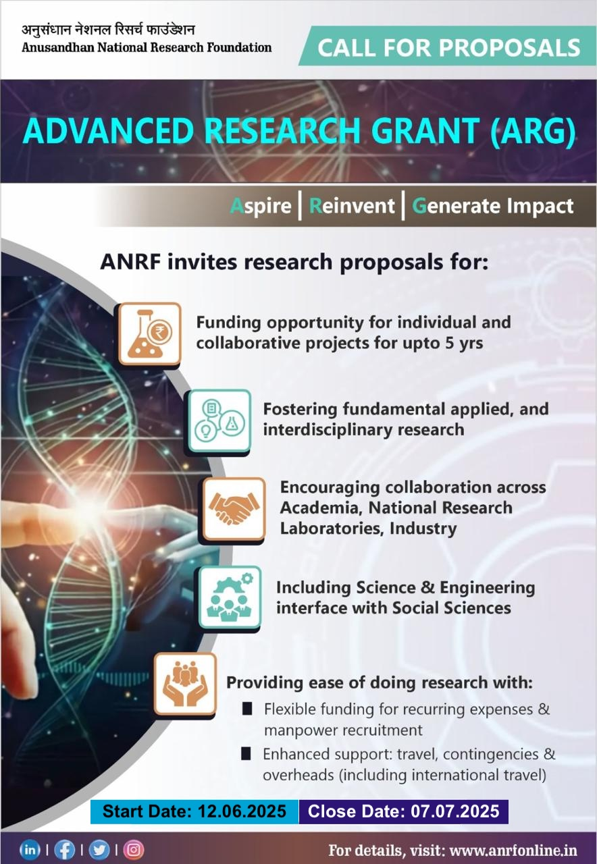

Slide 9
Core research Grant (CRG) | Advanced Research Grant (ARG)
Bottom-up, PI Driven in 17 sub-areas, Special calls in thematic areas | ARG (Individual Centric Projects)
3 years | 5 years
No upper limit for Budget | Mode I and More II: Upto Rs. 5 Cr Mode III : ANRF funding upto Rs. 5 Cr. Mode IV: Fixed Grant of Rs. 3 L / year + Overheads (For Mathematical, Theoretical and Quantitative Social sciences up to 200 openings annual)
Mode I,
Core
Mode-II,
Thematic
Mode III,
Industry Relevant
Mode IV,
MATRICS
FIRE,
(Industry Driven)
IRRD
(PI-Driven)

Slide 10
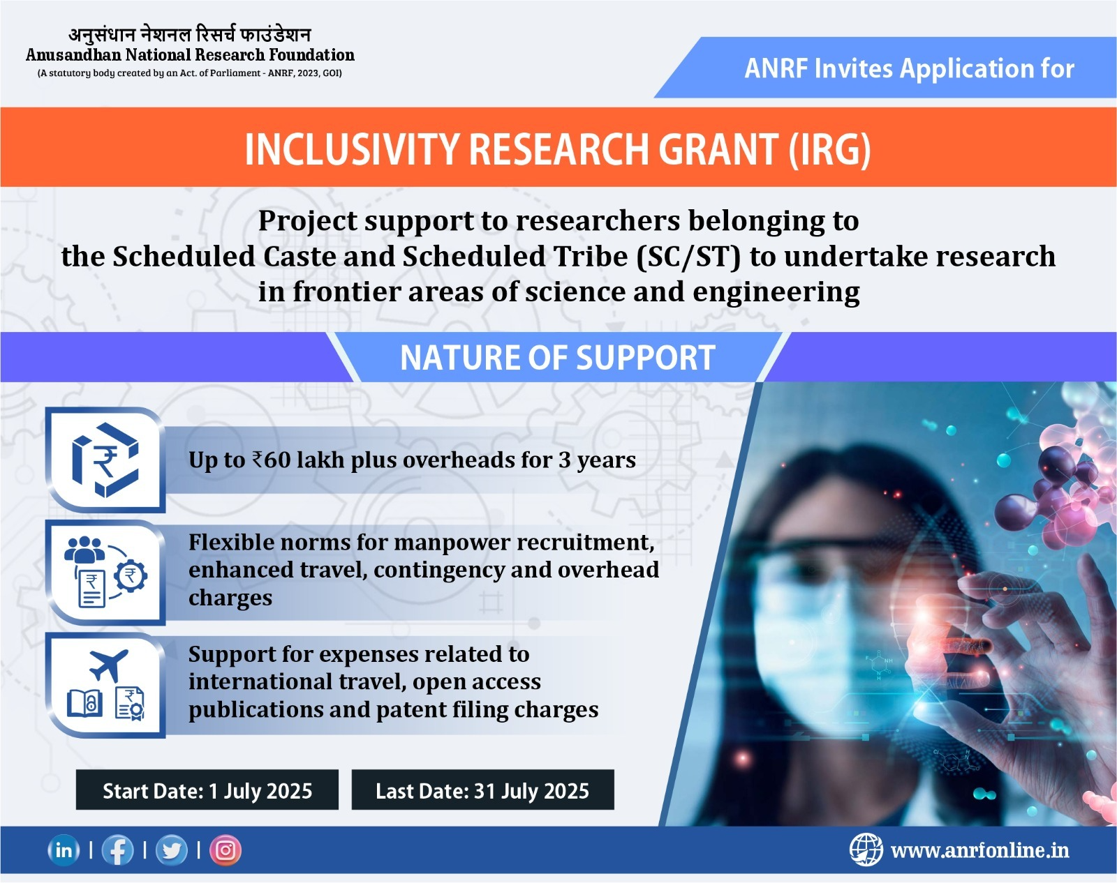

Slide 11
International Travel Scheme (ITS)
Scope: The ITS scheme is to provide financial assistance for presenting a original research paper or chairing a session or delivering a keynote address in an international scientific event held abroad (conference/seminar/symposium etc.). This scheme also provides support to young researchers (Age<35 years on the date of start of event) for attending workshop, short term training programmes and schools being organized outside India.
Eligibility : Applicant should be an active Indian researcher engaged in R&D work in recognized academic institutions or research laboratories in India.
The applicant should have an invitation for presenting an original scientific paper. Similar invitation is required in the case of young scientists attending training programmes such as short term courses, summer/winter schools, workshop etc.
The applicant should not have availed financial assistance under this Scheme during the last three years.
The scientific event should be of an international character. Invitation of personal nature such as for carrying out post-doctoral work, informal training programmes/courses, internship, observer-ship etc. will not be eligible for support.
Applicant must have obtained Master's degree in Science or Bachelor's degree in professional courses from a recognized University by the time of submission of application.

Slide 12
Financial Assistance to Professional Bodies and Seminar/Symposia (SSY), like ITS
The primary focus of the scheme is to support events having strong orientation towards scientific research in the areas of basic sciences, engineering, technology, agriculture & medicines. Events dealing with social science, management and those purely concerned with policy matters are generally not encouraged but may be considered as an exceptional case if there is a strong interface with mainstream areas of support.
The scientific/technical contents of the events, thematic relevance, contextual impact and extent & level of participation are key components for deciding the support worthiness and quantum of support for individual events.
Eligibility
Applicant should be and Indian Citizen residing in India.
The applicant(s) must hold a regular position in a recognized academic institution or in a national laboratory / recognized R&D institution.
Application should be submitted not earlier than 180 days and not later than 60 days, before the date of the event.
A4: The support is provided under the (upto Rs. 5L) :
Domestic Travel for Young and Senior Scientists (Indian Only)
Pre-Conference Printing (Announcements, abstracts etc.)
Contingency/Incidental Expenses (to meet working expenses/accommodation/venue costs during the event.)

Slide 13


Anusandhan National Research Foundation (ANRF) The Prime Minister’s Fellowship for Doctoral Research (PMFDR) An Industry-Academia Collaborative Initiative Industry Partners
Notes:
NOTE:
To change the image on this slide, select the picture and delete it. Then click the Pictures icon in the placeholder to insert your own image.

Slide 14
Objectives: PMFDR
Dual Exposure: To provide PhD scholars with immersive experiences in both academic and industrial research environments, fostering versatile scientific professionals, and encouraging knowledge exchange between academic institutions and the corporate sector.
Promote Industry-Relevant Research: To stimulate research in areas that have strong industrial relevance and commercial viability.
Contribute to National Development: To drive progress in key sectors such as science, technology, and engineering, contributing to the nation’s growth and innovation ecosystem.
Access to Advanced Research & Expertise: To provide industries with access to cutting-edge research and domain-specific academic expertise for solving complex, real-world challenges.
Enhance Professional Growth of PhD Scholars: To build the research, analytical, and professional competencies of doctoral candidates through advanced industry exposure.

Slide 15
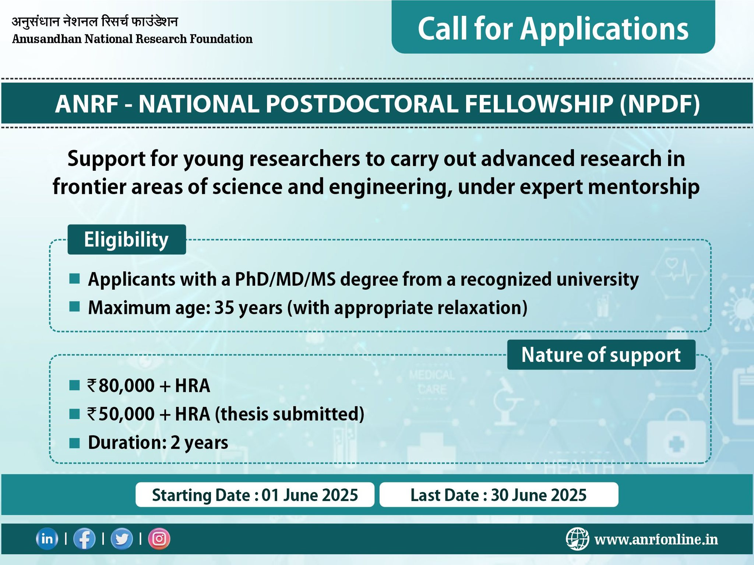

Slide 16
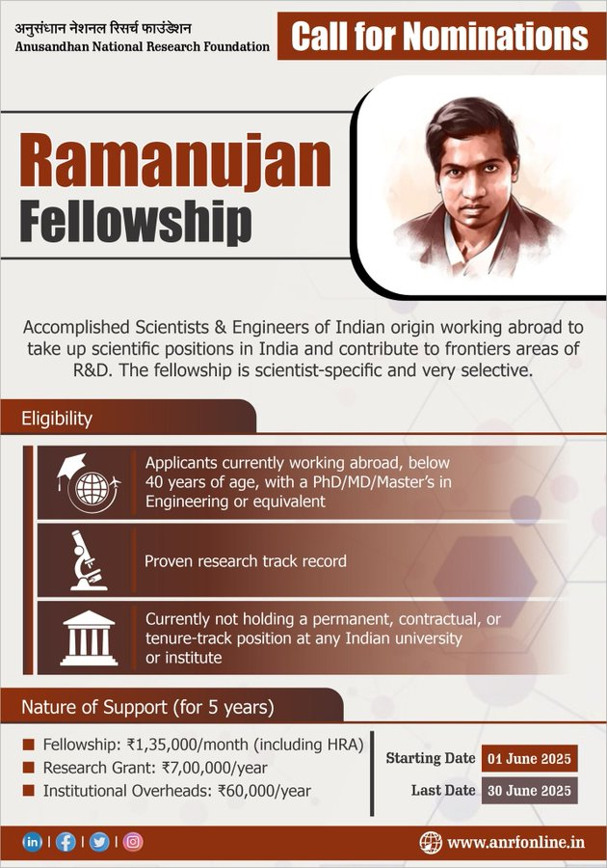
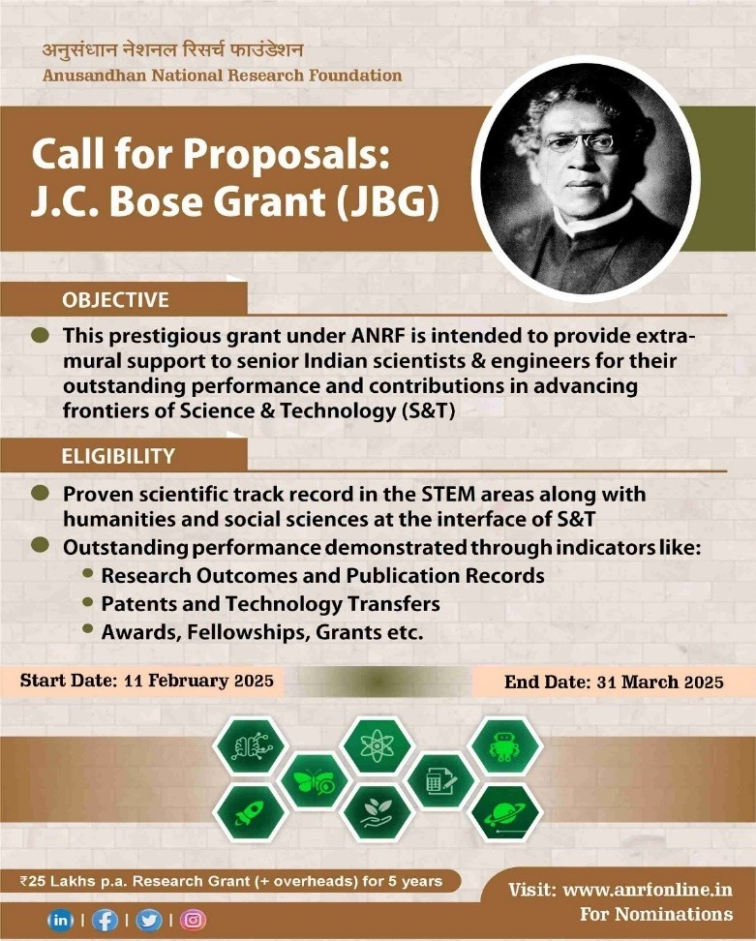

Slide 17
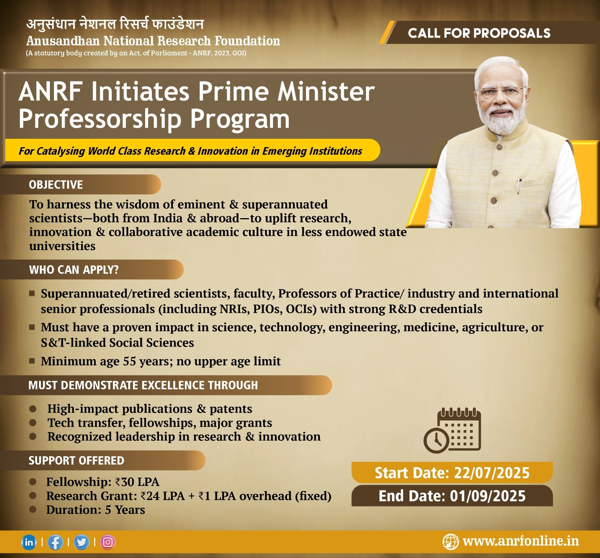

Slide 18
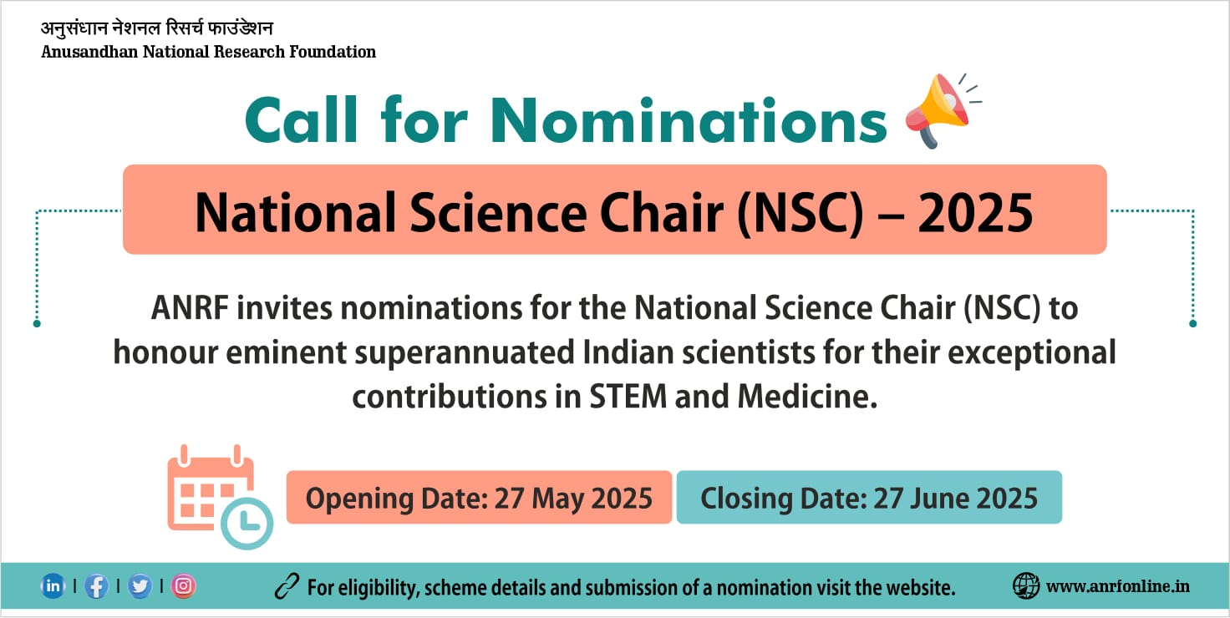

Slide 19
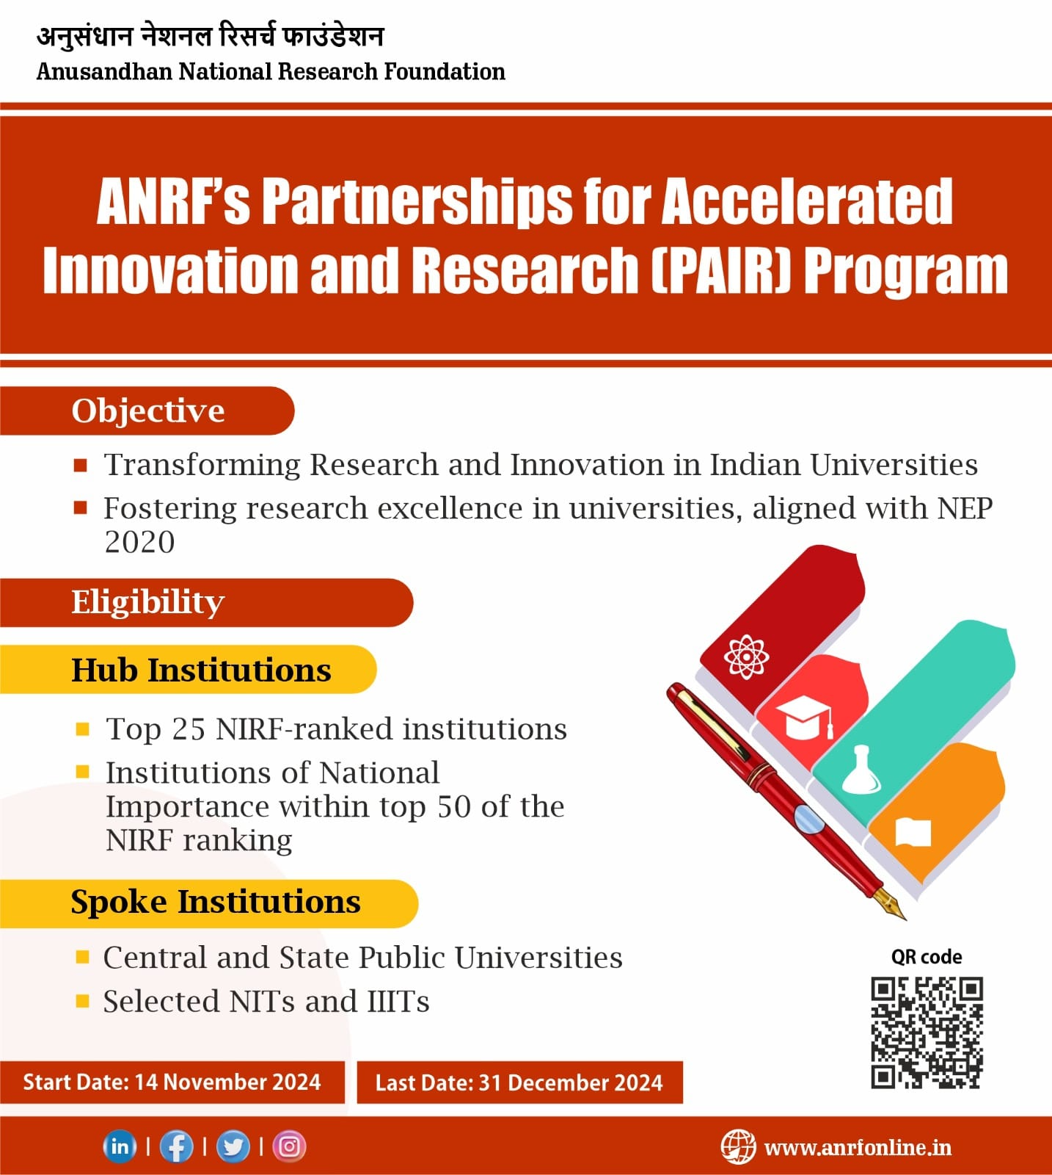

Slide 20
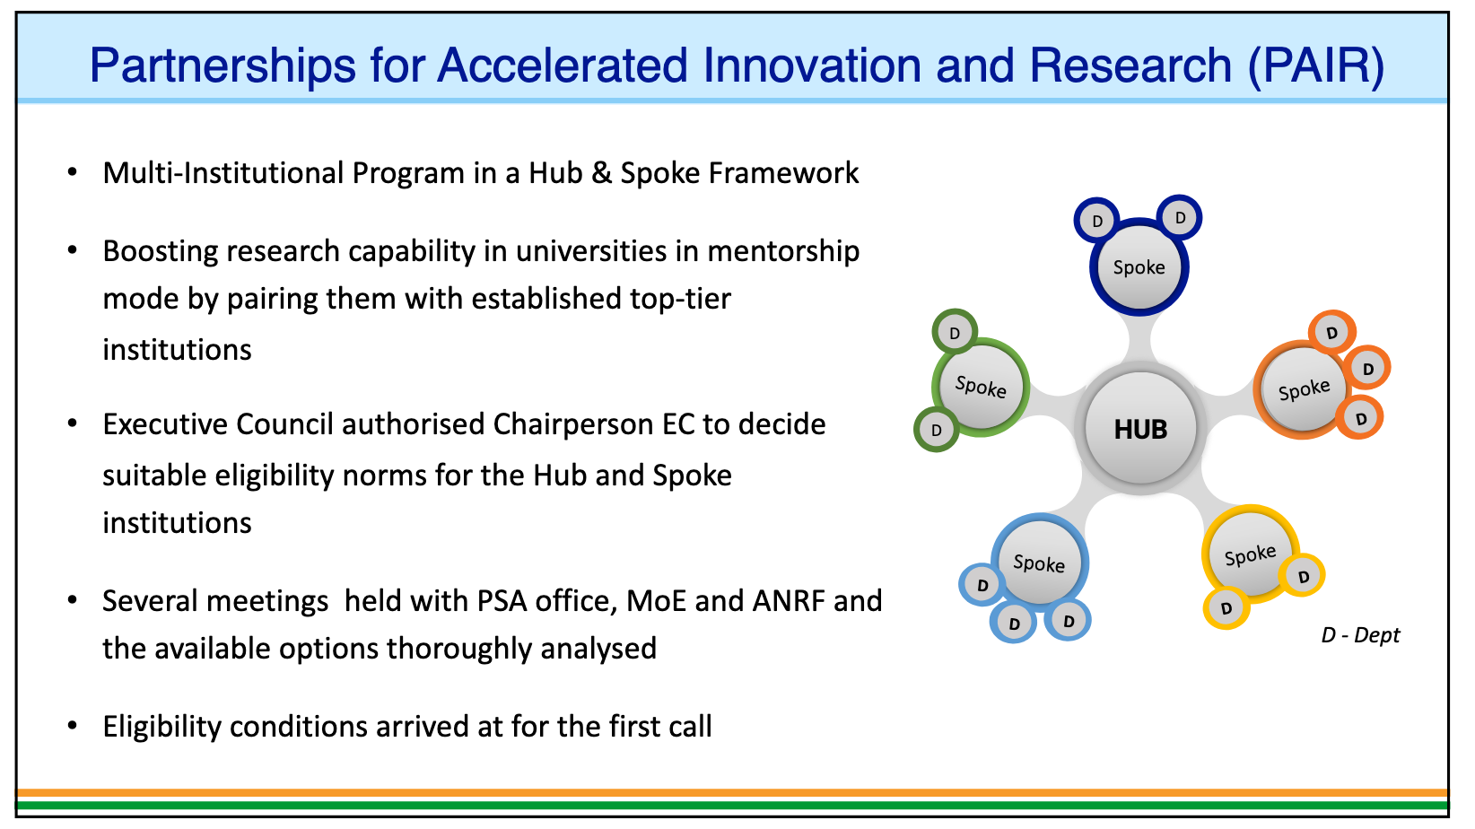

Slide 21
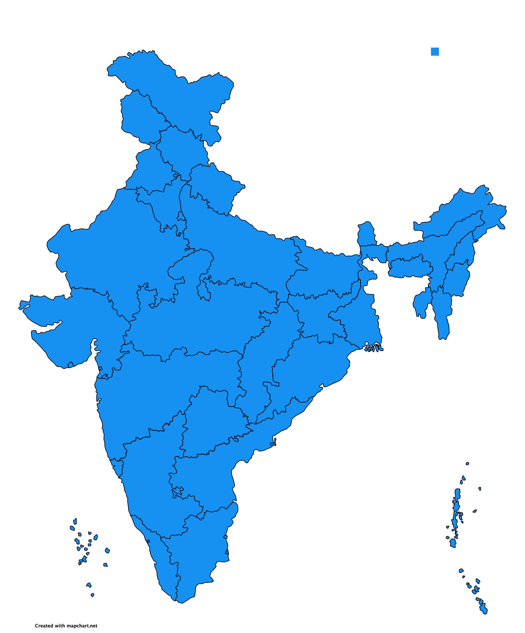
PAIR: Hub and Spoke Institutions (Cat A)
IIT Ropar
Panjab University
Himachal Pradesh University
Kurukshetra University
Shri Mata Vaishno Devi University
Mahatma Jyotiba Phule Rohilkhand University
Central University of Himachal Pradesh
Central University of Rajasthan
Jawaharlal Nehru University
Berhampur University
Cotton University
Delhi Pharmaceutical Sciences and Research University
Tezpur University
Central University of Punjab
Hubs | 7
Spokes | 45
State Univ | 32
Central Univ | 6
NIT/IIIT | 7
IIT Indore
Devi Ahilya Vishwavidyalaya
Rashtrasant Tukadoji Maharaj Nagpur University
Vikram University
Bundelkhand University
NIT Kurukshetra
IIIT Bhopal
IIT Bombay
Mumbai University
Sher-e-Kashmir University of Agricultural and Technology
Maharaja Sayajirao University of Baroda
COEP Technological University
IIIT Nagpur
IIIT Pune
NIT Goa
NIT Rourkela
Sambalpur University
Fakir Mohan University
Guru Angad Dev Veterinary and Animal Sciences University
International Institute of Information Technology Bhubaneswar
Odisha University of Agriculture and Technology
Veer Surendra Sai University of Technology
Odisha University of Technology and Research
IISc Bangalore
Kumaun University
Calicut University
Shivaji University
Bangalore University
Pondicherry University
NIT Nagaland
IIEST Shibpur
University of Hyderabad
Osmania University
Kannur University
Yogi Vemana University
Sri Venkateswara University
Mahatma Gandhi University
Central University of Karnataka

Slide 22
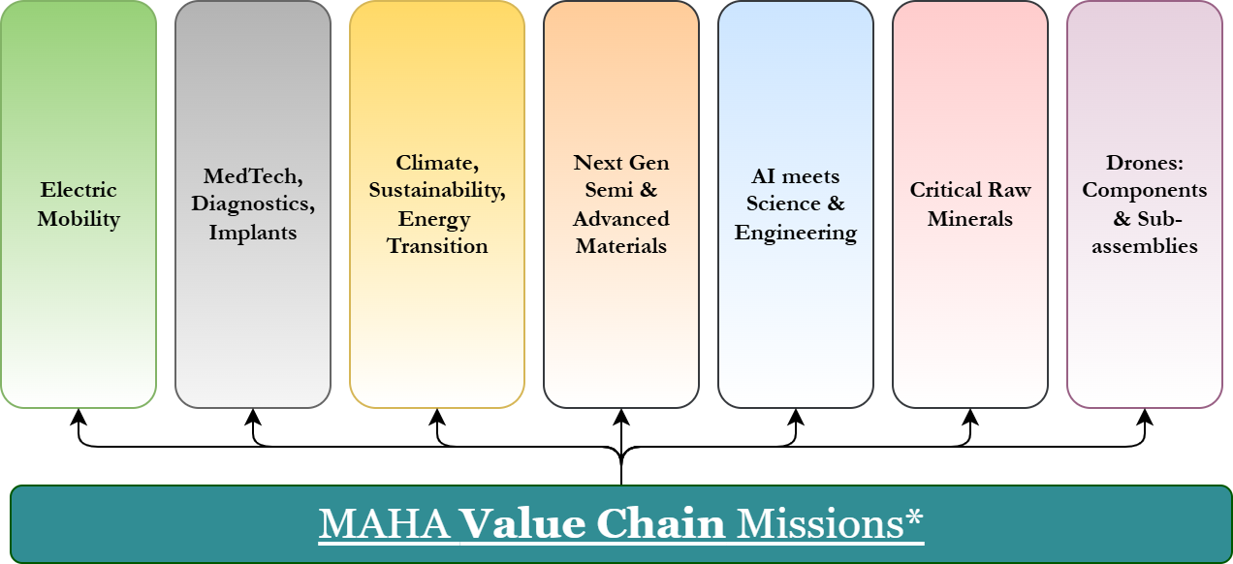

VERTICAL MISSIONS & CHALLENGES: EXAMPLE CANDIDATES
ANRF: Vertical
Cross-disciplinary, Cross-Ministerial & Partner co-funding to help prioritization
Candidate Missions / Challenges: value chain and India challenges
Mission-mode larger collaborative projects focused on outcomes; Economic value chain led & societally driven India challenges...
Larger investments, driving collaborations
Notes:
ANRF will drive missions to meet its mandates of economic and societal impact. This includes ANRF-led missions and +ANRF Missions (complementing lead ministries or states).
In ANRF-led missions, ANRF will coordinate ALL stakeholders, interdisciplinary sciences, technologies, translational ecosystems, and maintain a sustained campaign of research and innovation across all TRL levels to bootstrap new science-based value chains (economic impact), and/or societal impact pathways. At the same time ANRF recognizes the role of stakeholders and the private / public sector in scaling up impact. ANRF will aim to graduate missions once enough traction exists, and its catalytic role and capacity can be redeployed elsewhere.
The depicted missions above are an illustrative list of ANRF-led missions where ANRF drives the mission in an anchor role and brings together all stakeholders who in-turn will have significant skin in the game; and fosters sustained & creative collaboration till the value-chains take off , or societal missions are well anchored for the long term in delivering stakeholders.
In addition, ANRF can partner with ministries & states on “+ANRF Missions.” An illustrative list includes AI For Science, Reimagined Defense & Security, Advanced Materials, Next Gen Renewable Technologies & Systems (Photovoltaics, Wind, Batteries, Green H2, …) , Leapfrog Health & Medical Technologies, Reimagined Drug/Pharmaceuticals, Reimagined Infrastructure.
In all cases, ANRF is ultimately a catalyst to accelerate a reaction with exponential impact. Another analogy is to think of ANRF as all the supporting systems to ensure an airplane (“the ecosystem”) takes off. The plane taxies from the gates, coordinates with air traffic control, gets to the runway, accelerates and finally takes off. Long term impact post take-off will be driven by appropriate stakeholders.
Specific ANRF missions at any time will be prioritized based upon stakeholder consultation, co-investments, national priorities, potential for economic leadership, societal impact & approved by Executive Council (EC) on the authority of Governing Board (GB).
+ANRF participation by partners in the ANRF missions are welcome. +ANRF Partnerships (see next section) can also be used as incubation for future missions. ANRF will have an open and non-discriminatory approach to partners; but allow individual partners the agility & ability to express their unique value propositions.
ANRF will think of Missions from a collective outcome stand point, i.e. NOT as a collection of individual projects, and within individual projects not just outcomes such as high quality publications (which are very important and necessary, but NOT sufficient). Impact on the nation via economic or societal value chains, the development of high end human capital, and collaborative social capital in the process is what matters. There are two broad categories of outcomes: 1. Value-Chain Missions: To bootstrap and jumpstart new deep science- and deep technology-based value chains to emerge from India.
2. Societal Missions: To reimagine societal challenges, develop leapfrog / transformational solutions to significant societal challenges using an interdisciplinary approach across stakeholders.
By necessity, this will involve the participation of multiple types of stakeholders and entities (academia, industry, MSMEs, startups, labs, non-profits/NGOs, foundations, various parts of government), the sponsorship at the top most levels of each entity involved. Each mission will also focus on the goals/ends which are based upon impact, but have flexibility to pivot, with appropriate governance guard rails. High quality technical artifacts such as papers, patents etc are expected to be necessary, but NOT a sufficient part of the outcome measurements.
Detailed qualitative and quantitative assessments (with appropriate flexibility to empower judgement, and not penalize pivots) will be conducted. The heads of institutions will also be made formally aware of each major evaluation, and subsequent adjustments in resourcing, if any.
A high level apex committee of cross-disciplinary, cross-institutional experts will be convened to continually refine governance norms; and a sustained effort to monitor the quality of governance & process will be created that reports to the apex committee. ANRF will accumulate core capabilities to quickly set up, execute, govern, coordinate and graduate missions, supported by technical and business advisory councils, and mission governance / outcomes management expertise.

Slide 23
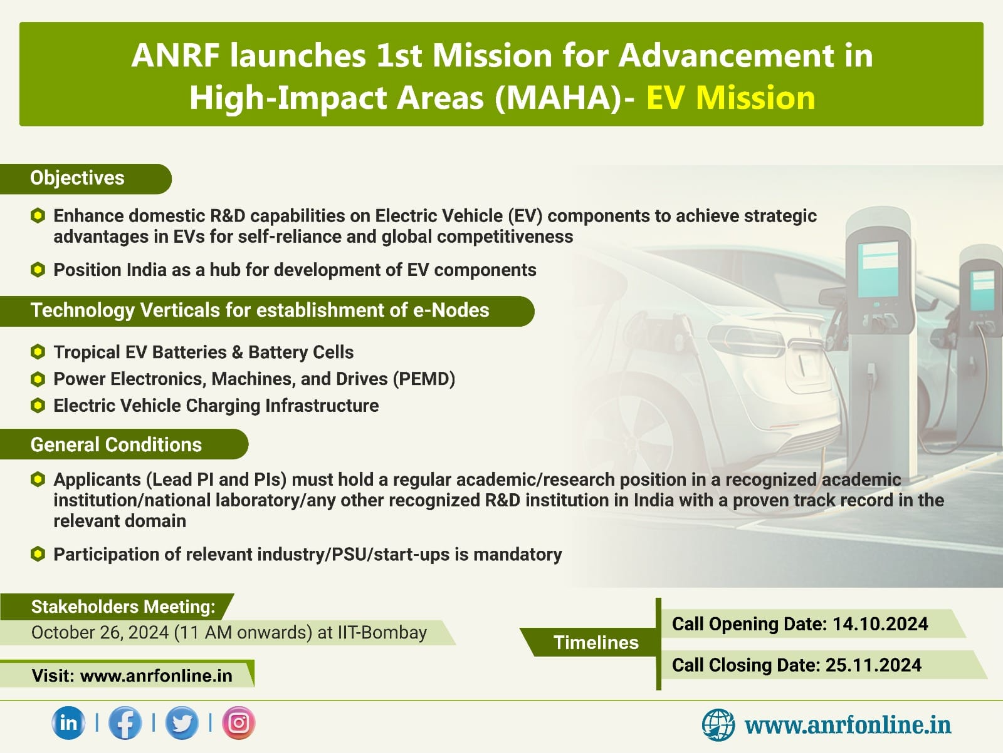

Slide 24
Mission for Advancement in High-impact Areas - MAHA
To address scientific challenges & advance the frontiers of technology in key scientific areas
Priority-driven and solution-focused research in mission mode
Multi-investigator, Multi-disciplinary, Multi-institutional Program in Identified Areas
Nature of Support
Project Funding : Proposed objectives with targeted and outcome-oriented deliverables.
Duration: 5 years
Participation of relevant industries/start-up is mandatory.
Post-doctoral fellows
Electric Vehicle (EV) Mission is the first priority area of focus under MAHA

Slide 25

Electric Vehicle Mission (EV-Mission)
To promote research & development of Electric Vehicle (EV) adoption in India.
Promoting Atmanirbhar Bharat & aligning with the goals of Viksit Bharat.
Positioning India as one of the global hubs for development of EV components.
Bridge the gaps through targeted research -- indigenization / value chain self-sufficiency.
Aiming global leadership by working on areas not succeeded well anywhere globally.
Fostering an eco system by R&D in key EV components such as batteries, motors and controllers, power electronics, chargers, grid interface etc.

Slide 26
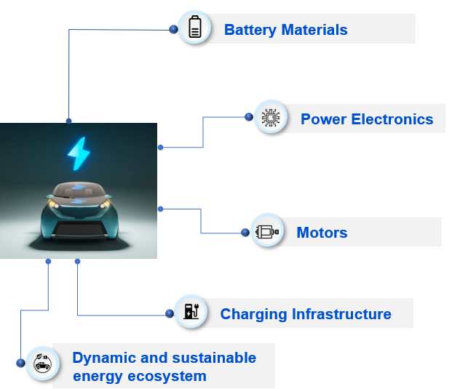
ANRF: Vertical
MAHA: EV Mission
Support state-of-the-art research to develop EV technologies and capabilities in consortium mode
Call announced in Oct 2024
Seven consortia-mode projects called eNodes supported
Thrust Areas
eNodes Supported
Tropical EV Batteries and Battery Cells
Indian Institute of Technology (BHU)
ARCI, Hyderabad
Power Electronics, Machines and Drives
Indian Institute of Technology Bombay
CSIR-Central Electronics Engineering Research Institute (CSIR-CEERI), Pilani
National Institute of Technology Karnataka, Surathkal
EV Charging Infrastructure
Indian Institute of Technology Kanpur
Indian Institute of Technology Kharagpur

Slide 27
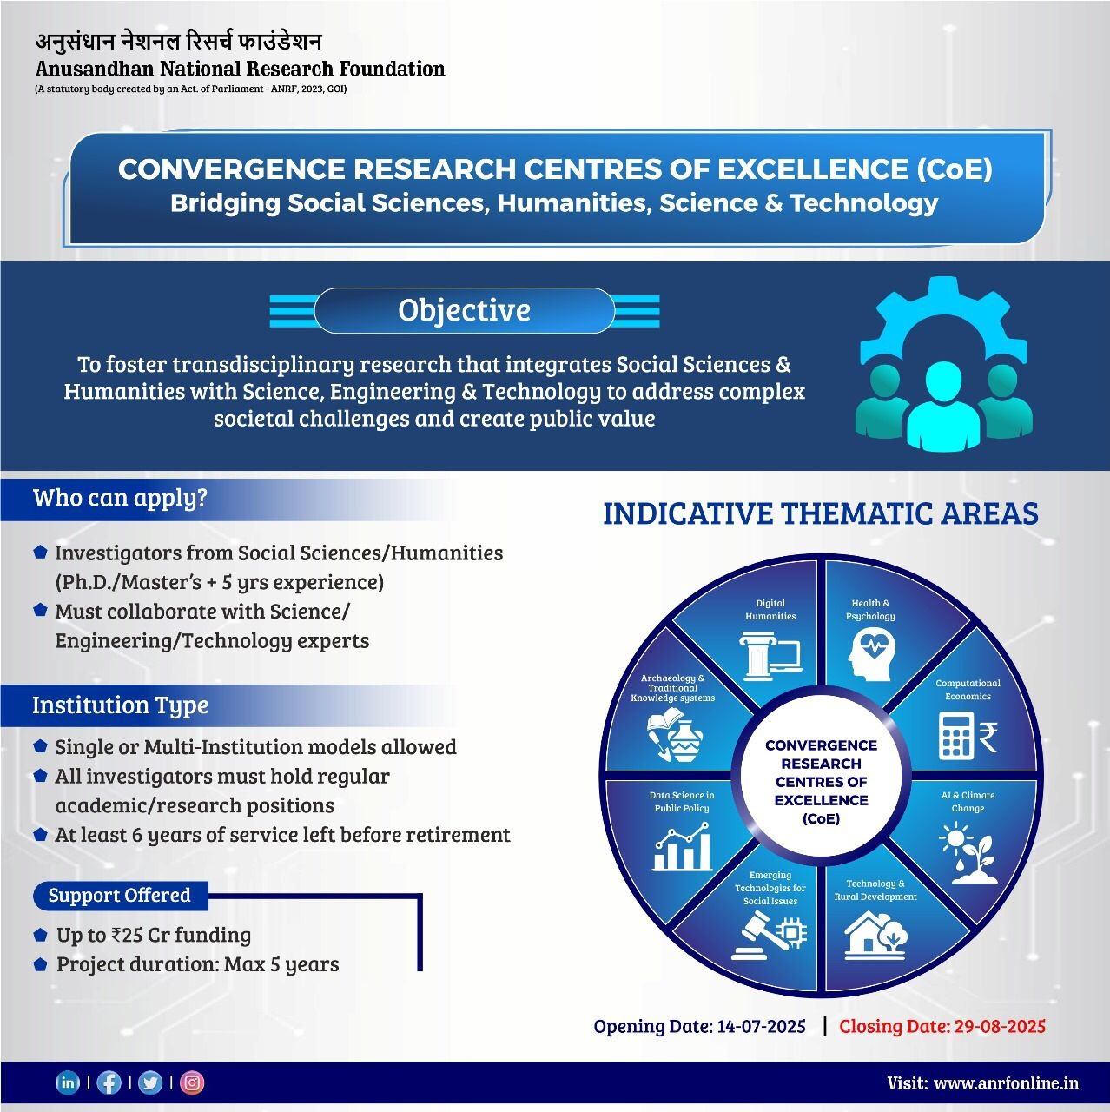

Slide 28


Interdisciplinary Research in Social Sciences and Humanities at the Interface with Science & Engineering/Technology
Science & Engineering
Social Sciences & Humanities
ANRF: Horizontal
Convergence Research Centers of Excellence: Bridging Social Sciences, Humanities, S&T
Addressing global challenges and achieving Sustainable Development Goals
Solving economic, environmental and social problems associated with expanding economy and evolving society
Research on public policies that are scientifically sound, socially equitable, culturally rooted and ethically responsible

Slide 29
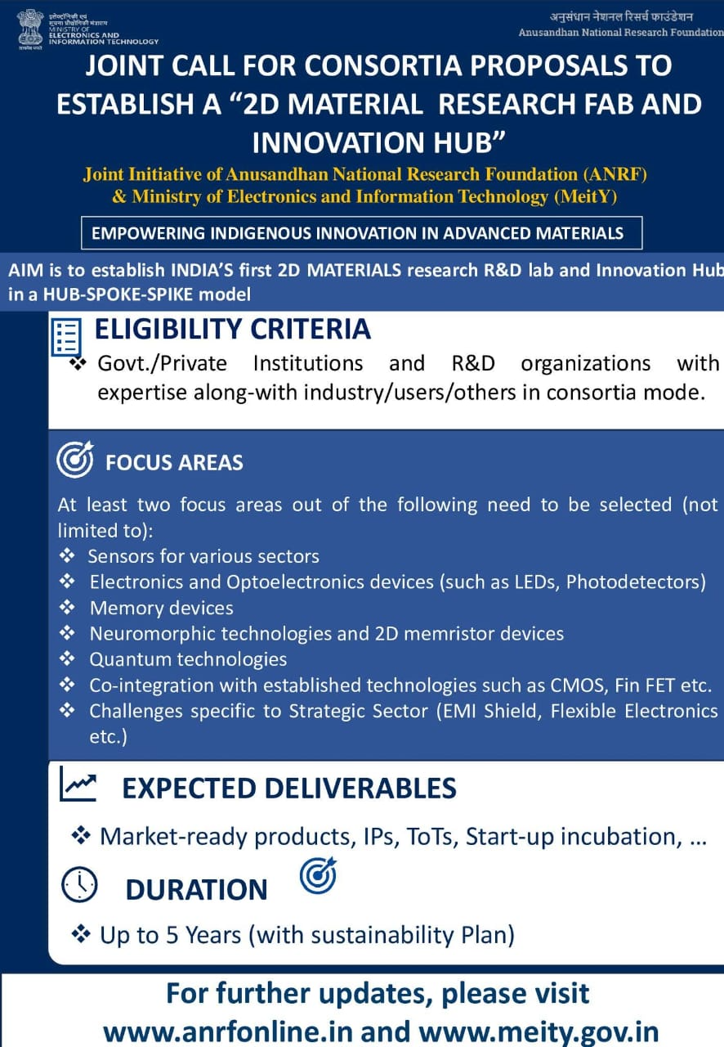

Slide 30


Slide 31
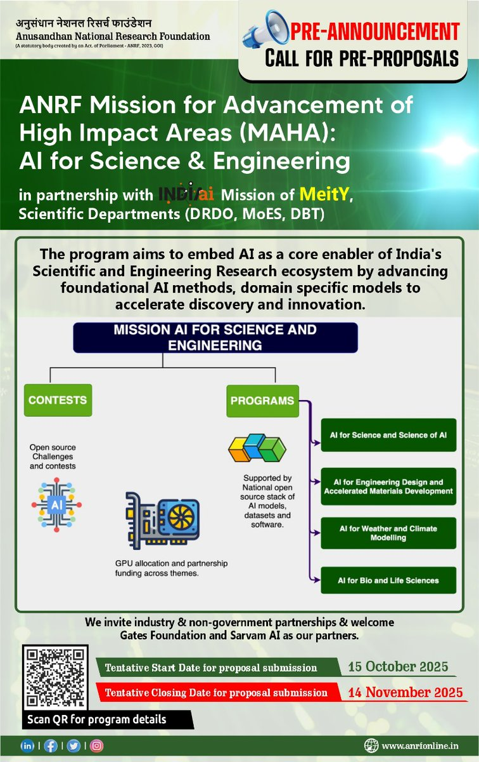

Slide 32
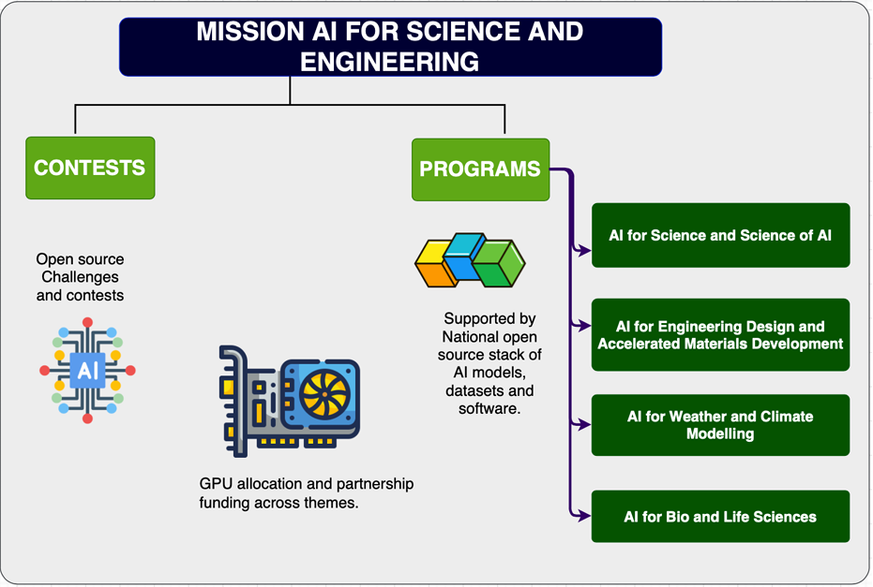
MAHA AI For Science & Engineering
ANRF: Vertical

Slide 33
Track I: Programs (in Partnership with MeitY for GPUs):
Program I: AI for Science and Science of AI (ANRF)
Hybrid AI-HPC Approaches for Scientific Discovery
Reimagining Design and Simulation through AI
AI for Next-Generation Batteries and Sustainable Energy Storage
AI for Medical Imaging
AI for Computational Chemistry
AI for Astrophysics, Cosmology, Nuclear and High Energy Physics
AI-guided Molecular Design or Quantum phenomena
AI methods inspired by Scientific Disciplines
AI for Earth & Geological Sciences & Engineering
AI for Multi OMICS for Plant and Animal Sciences
AI for Mathematics and Mathematical Reasoning
Program II: AI for Engineering Design and Accelerated Materials Development (ANRF with DRDO) Accelerating Materials Discovery and Optimization with AI
Novel Materials design through AI for defence applications
Digital Twins for naval systems like AIP, advanced propellers, unmanned underwater systems
Real-time fluid dynamics modeling
AI-enabled design and maintenance of maritime systems

Slide 34
Program III: AI for Weather and Climate Modeling (ANRF with MoES under Mission Mausum)
a. AI emulators for physics parameterization and earth system models
Multimodal rainfall nowcasting
Climate modeling and environmental forecasting
Program IV: AI for Bio and Life Sciences (ANRF with DBT) Biomanufacturing
AI-assisted strain selection and yield optimization
Enzyme design and biocatalysis
AI for Drug Discovery and Cell & Gene Therapies
AI for Computational Biology
AI for Protein and mRNA biologics
AI for Therapeutics and Vaccines
Research grants of up to Rs 30 Crore for a period of 3 years may be awarded, inclusive of GPU usage costs. In rarer cases, upto Rs 50 Crore will also be considered, commensurate with the projected deliverables and impact of the proposal.
The budgetary provision for GPU usage must not exceed 70% of the total project cost.
GPU usage will be supported only through MeitY's GPU-as-a-Service; purchase of GPUs or other HPC equipment will not be funded.

Slide 35
Track - II (ANRF in partnership with MeitY)
National Challenges through open source contests: Under the broad umbrella of the AI-SE mission, open source challenges and contests will be undertaken to build a national common of open-source AI models, datasets, and evaluation benchmarks. Grand challenges, public competitions, and community benchmarking will be the goal of this initiative. A key purpose of this effort is to foster the engagement of the wider scientific community and latent talents, including researchers, students, and innovators from Tier II and Tier III institutions and universities, thereby ensuring inclusive participation and broad-based capacity building in AI for Science and Engineering.
Nature of Support for Contests and Challenges: The mission will have national competitions over the year, to build open-source AI datasets, build opensource models, and benchmarks.
Around 10 national competitions over the year will be targetted.
The competitions are open to all Indian citizens or OCI holders.
The competitions will entail prizes and access to GPUs through MeitY's shared infrastructure.
The expected deliverables will be build datasets or build models for opensource.
The applicants should affiliate/partner with any Indian academic institutions ornational research labs if they win the contest, for GPU access/allocation.
The PIs/Co-PIs must commit to releasing intermediate artefacts under approved open-source licenses. The details of the licence can be found here...
Implementation of Open Source Challenges and Contests: ANRF and MeitY will evolve mechanisms to support competitions to lead the development of national open-source AI models, datasets, and benchmarking platforms, including large-scale competitions to crowdsource innovation. In addition ANRF and MeitY may procure support services for this AI Mission.

Slide 36
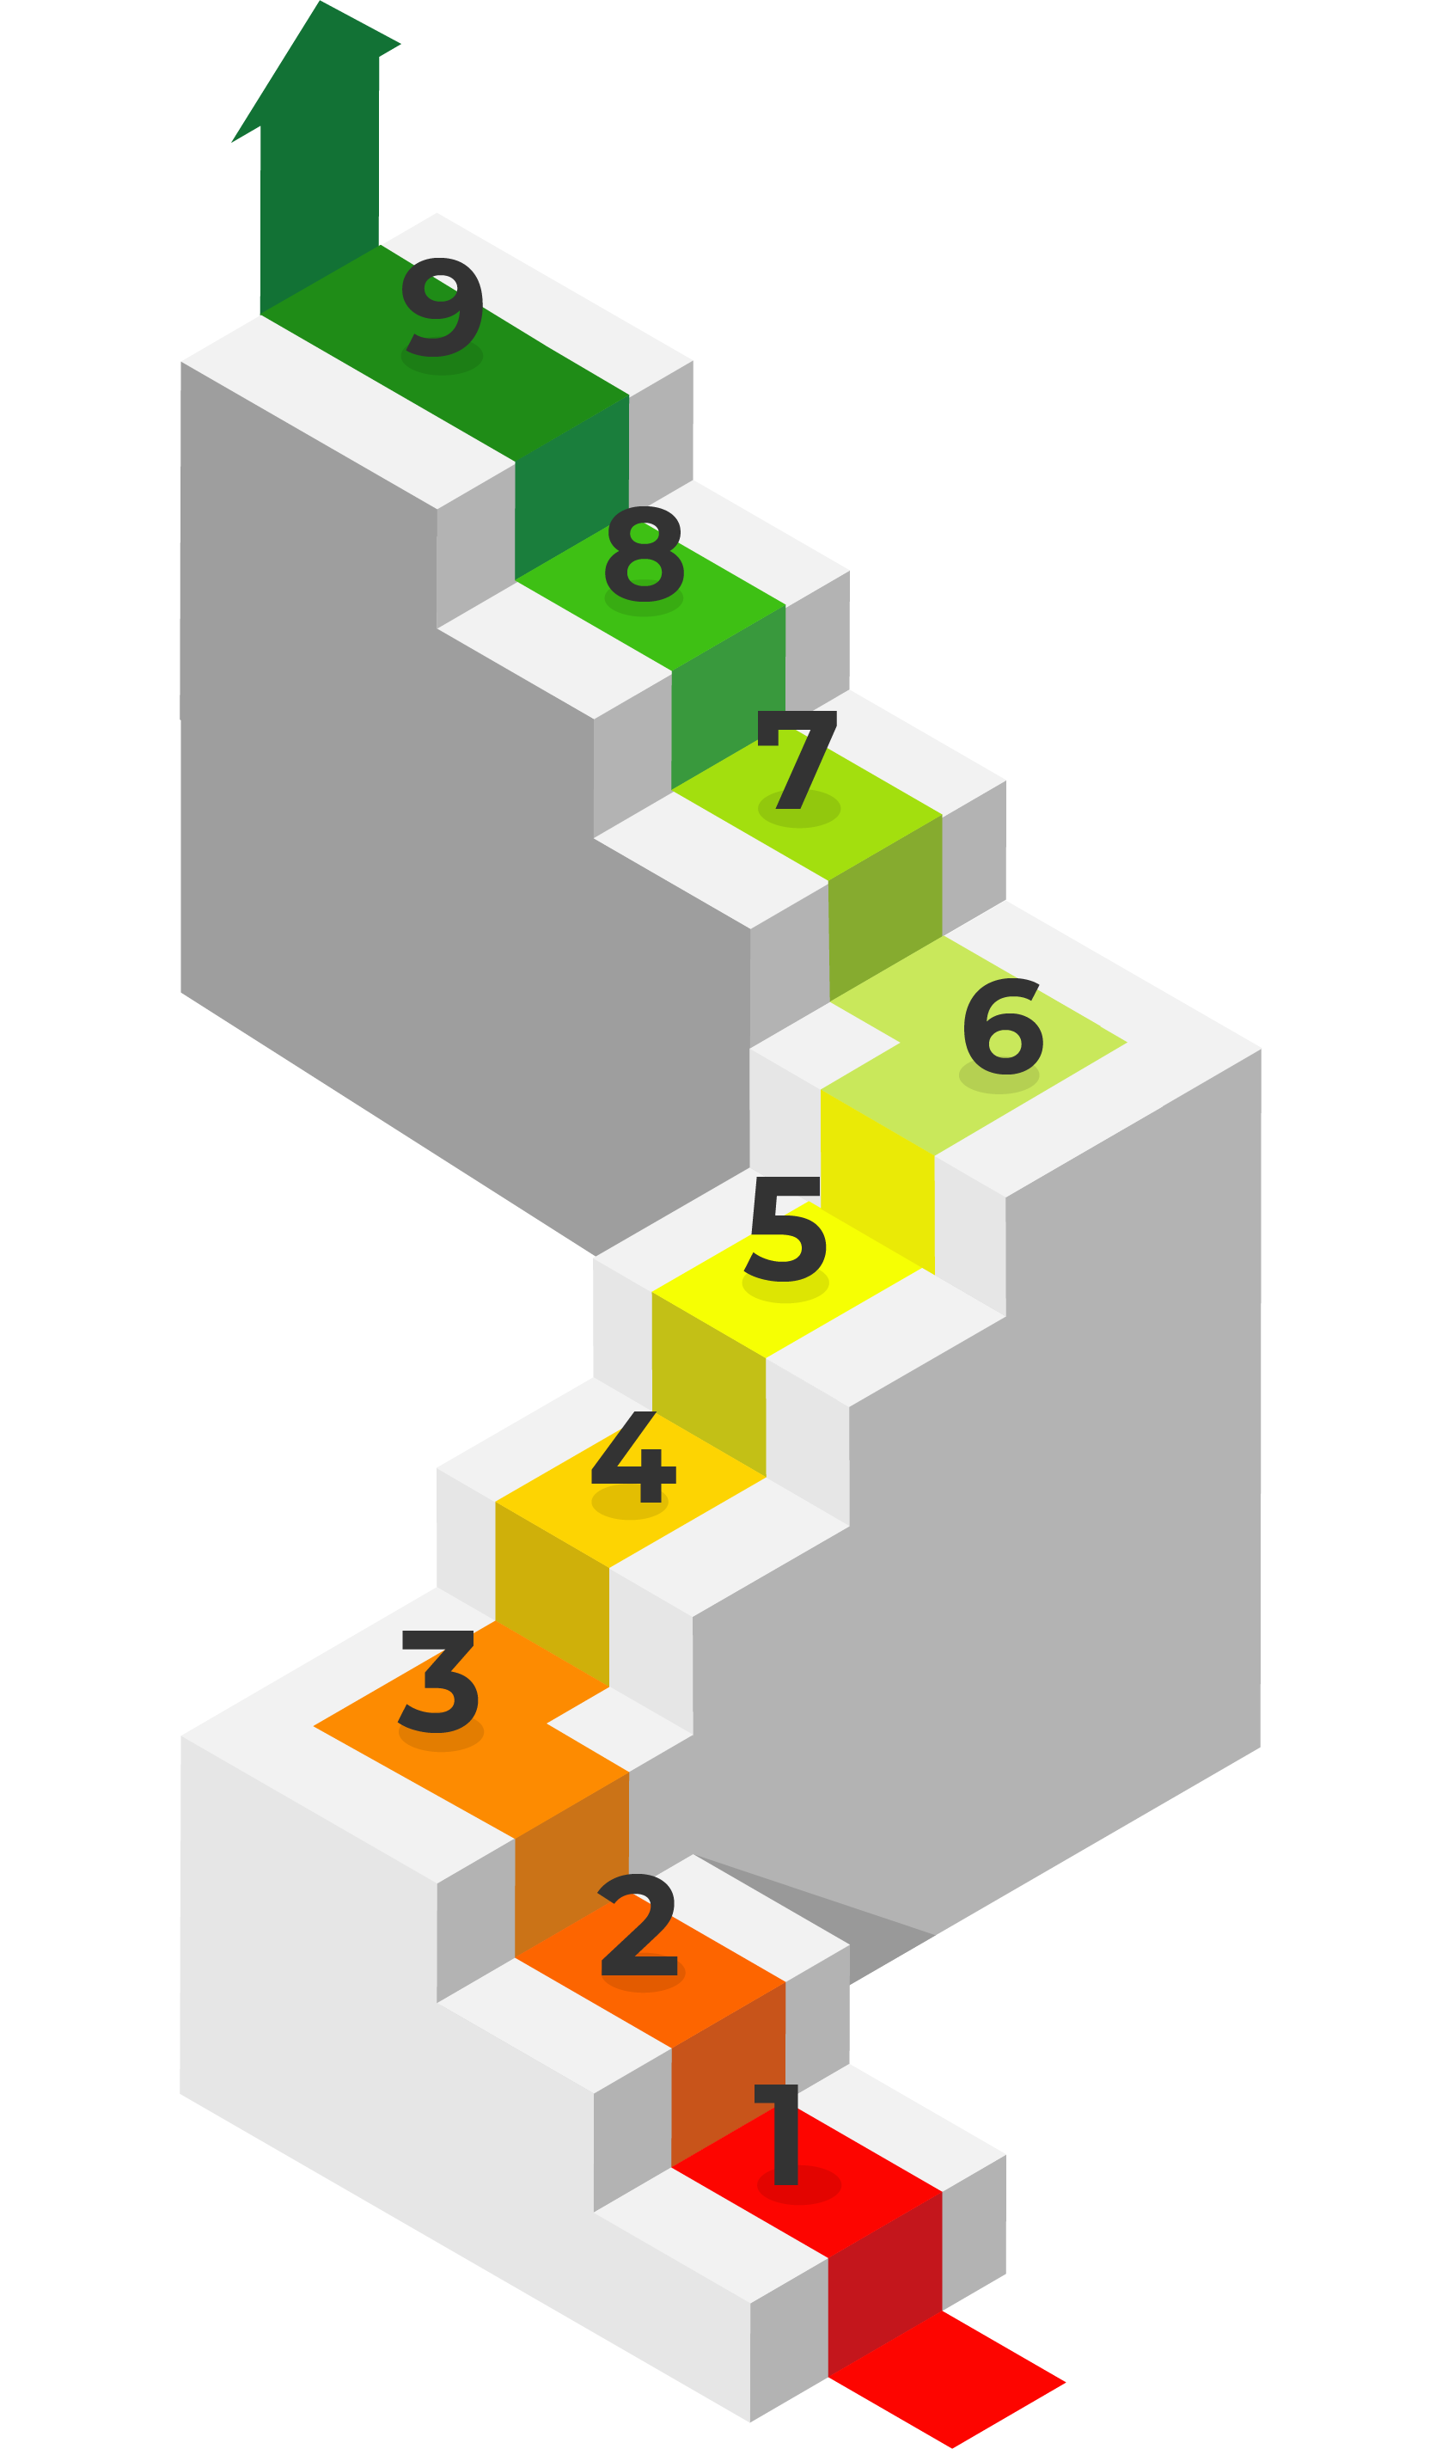
ANRF “Core” and RDI: CATALYZE the Rise of India as an R&D Powerhouse
Technology Readiness Level (TRL)
Commercialisation
ANRF RDI
Translational & Scale up with Private Sector
{Patient Capital, Debt/Equity: NOT Grants}
RDI Fund
ANRF Core
Foundational Transformation +
Mission-Mode Research +
Private Partnerships {Grant-in-aid focus}
Prototype
ANRF CORE
Basic R&D

Slide 37

Proposal Writing: Certain Tips…..
Strictly follow the format and instructions
Title: Should avoid fancy keywords such as “novel”,, “first” etc…..
Objectives: Propose achievable objectives in 3 years. Pl avoid too many objectives which can be achievable during the project tenure.
Summary: This should outline the overall project description.

Slide 38
1. Origin of the Proposal: (Maximum 1 page)
(Scientific rationale for doing this work should be elaborated)
2. Review of status of Research and Development in the subject
2.1 International Status: (Maximum 2 pages)
(Researchers working in the area worldwide and their contributions must be properly highlighted with recent references and reviews
2.2 National Status: (Maximum 1 page)
2.3 Importance of the proposed project in the context of current status (Maximum 1 page)
2.4 If the project is location specific, basis for selection of location be highlighted: (Maximum 1/2 page)

Slide 39
3. Work Plan:
3.1 Methodology: (Maximum of 5 pages)
(It should contain all the details of how each of the objectives will be addressed. This section must be detailed and have clear plans, not vague and generalized statements. It should have several schemes, tables, figures, equations etc. in addition to text, explanation and justification of why the project research plan will work)
3.2 Time Schedule of activities giving milestones through BAR diagram. (Maximum 1 page)
3.3 Suggested Plan of action for utilization of research outcome expected from the project. (Maximum ½ page)
3.4 Environmental impact assessment and risk analysis. (Maximum ½ page)

Slide 40
4. Expertise:
4.1 Expertise available with the investigators in executing the project:
( Maximum 1 page)
4.2 Summary of roles/responsibilities for all Investigators:
(If the proposal contains more than one Investigator, it is important to clearly mention the role of each Investigator in implementing the objectives of the proposal. The Board does not encourage Investigators who do not have specific scientific role in the proposal)

Slide 41
5. List of Projects submitted/implemented by the Investigators
(All the Investigators should list out details of the Projects submitted, implementing and completed by them. The list should start with the Projects implemented by the Principal Investigator, followed by Co-PI1, Co-PI 2 etc.)
5.1 Details of Projects submitted to various funding agencies:
5.2 Details of Projects under implementation:
5.3 Details of Projects completed (and publications) during the last 5 years:
6. List of facilities being extended by parent institution(s) for the project implementation.
6.1 Infrastructural Facilities:
6.2 Equipment available with the Institute/ Group/ Department/Other Institutes for the project:

Slide 42


Slide 43
EV-Mission: Scope and Technology Verticals
Centered around state of the art research developing technologies and capabilities in consortium mode- Absorption by the industry and thereon, the market.
Cell Technologies and Materials
Motors
Implementation of Batteries in EVs
Battery Circular Economy
Power Electronics
Control of Motors for EVs
High Power Charging Methods
Charging Infrastructure and Grid Issues
Low Power Charging Methods and Charging Infrastructure
Power Electronics, Machines and Drives
Electric Vehicle Charging Infrastructure
Tropical EV Batteries and Battery Cells

Slide 44
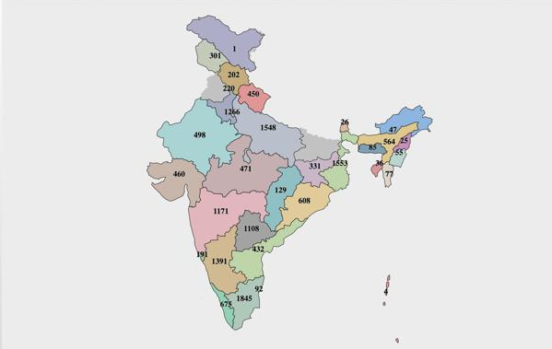


ANUSANDHAN MASTER PLATFORM OF INDIAN RESEARCH AND INNOVATION
ANUMAPI
MINISTRIES &
DEPARTMENTS
INSTITUTES
UNIVERSITIES
R&D LABS
INCUBATORS
CoE’s
NEWS FEED
TECHNOLOGIES
ACP
GEOGRAPHICAL REACH
KPI
R&I FEEDS
TOP PUBLICATIONS
INNOVATION
PATENTS
Natural Language Query
IMPACT
S&T INDICATORS
AI-ENABLED ANALYTICS

Slide 45

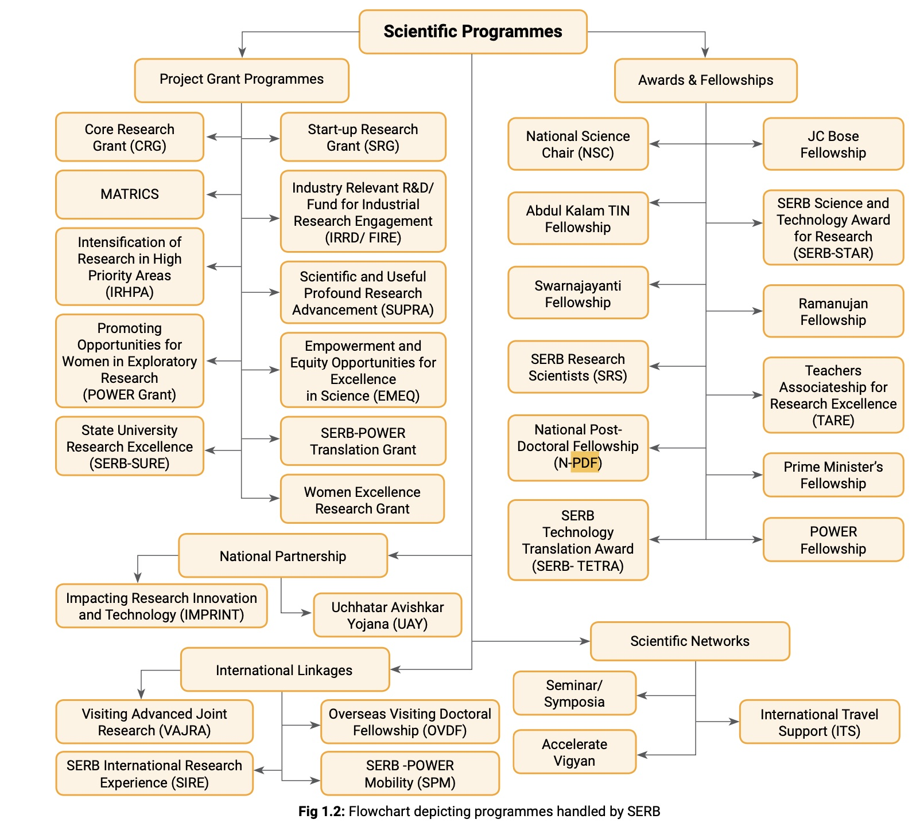
SERB Annual Report 2022-23

Slide 46
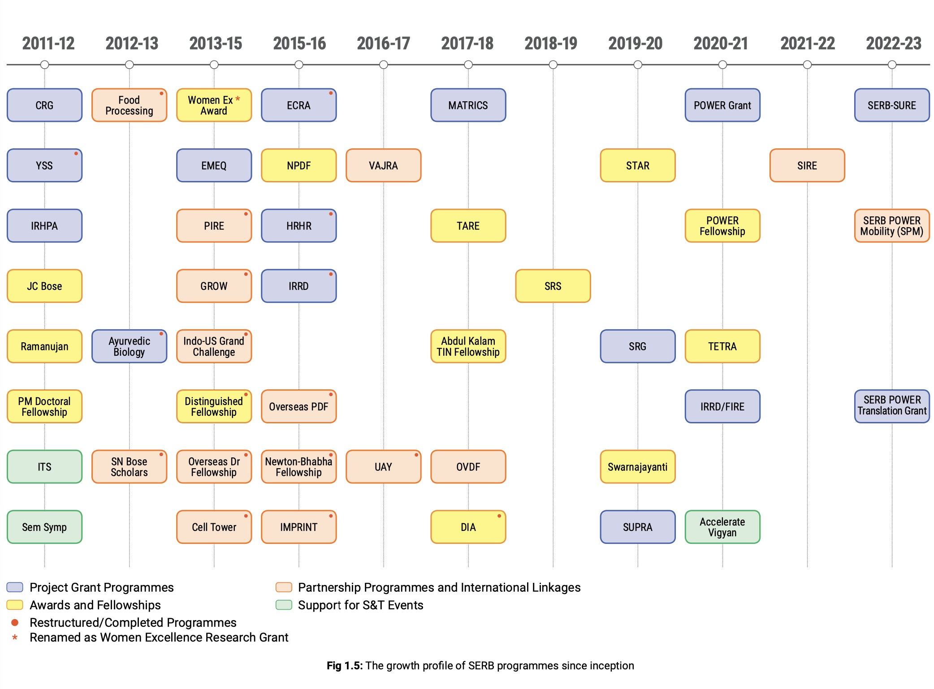
SERB Annual Report 2022-23

Slide 47
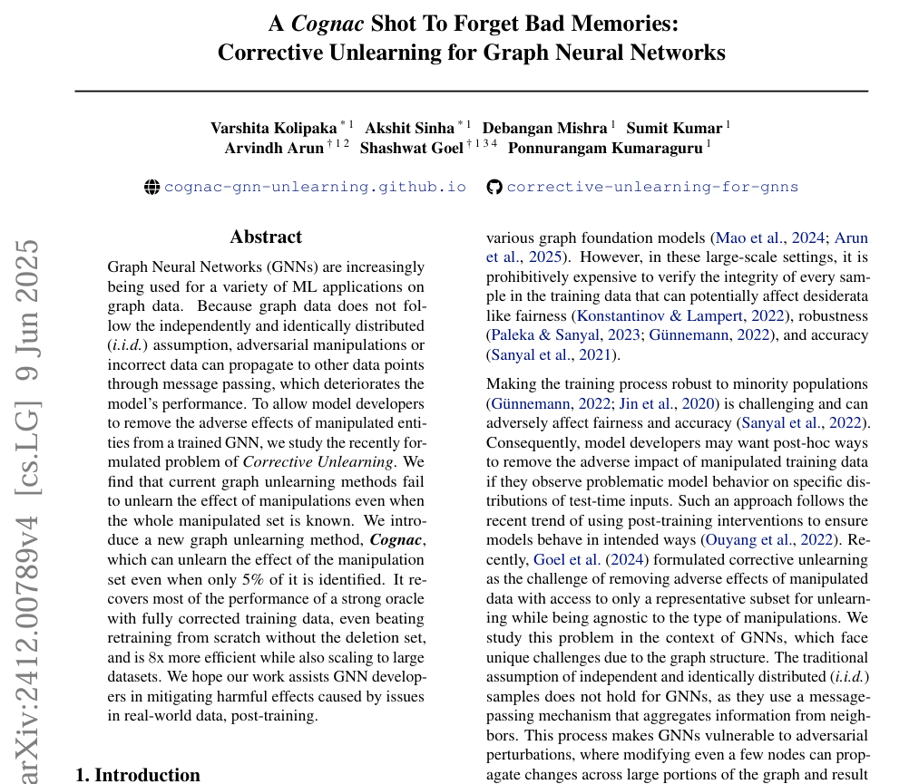
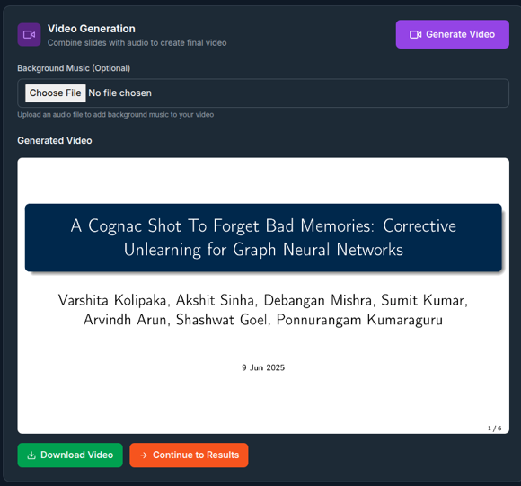
SARAL: Democratising Research using AI & Social Media
SARAL – Simplified & Automated Research Amplification and Learning
Demystify and make research content accessible
Publications Videos, Podcasts, Multiple Languages, Posters, Presentations … (integrated into research workflows)
Complemented by an “Open Science Publishing Platform” and a “Anusandhan Community Platform” (problems, mentors, mentees)
Technology transfer (TTO) Acceleration: papers, patents -> product ideas, GTM linkages, VCs etc
Social Media, Open publishing (preprints), Open Data Sharing as a requirement for technical dissemination for ANRF grantees

Slide 48
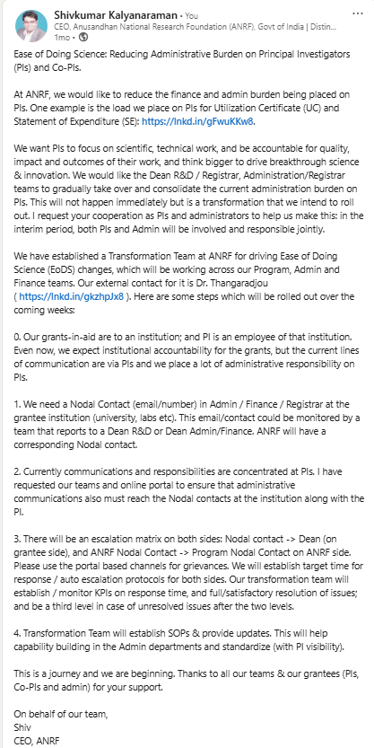
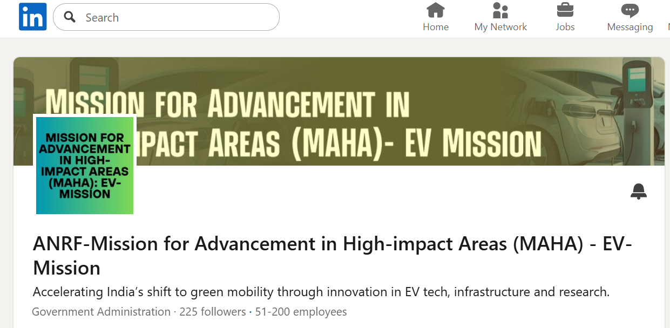
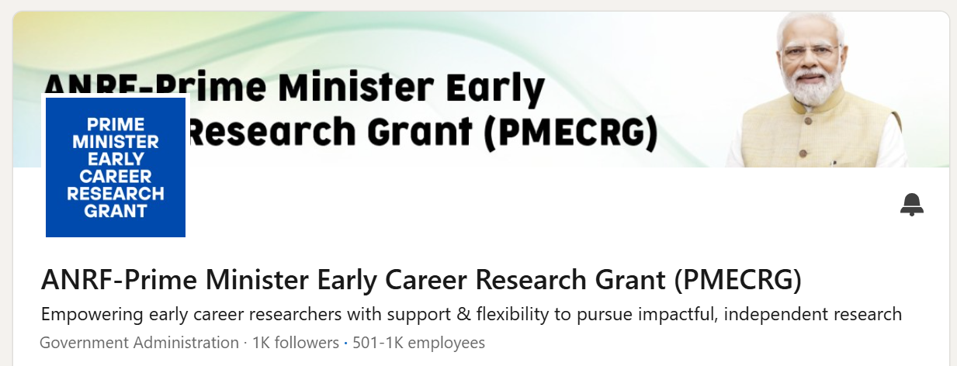

Social Media: Amplifying Impact & Ease of Doing Science

